Slide 1
FILE HANDLING

Slide 2
What is module, package, Library ?
Module: A module is a just single python file (.py) that contains functions, classes, variables.
Package : collection of modules organized in a folder that contains an (__init__.py)
Library: collection of packages;

Slide 3
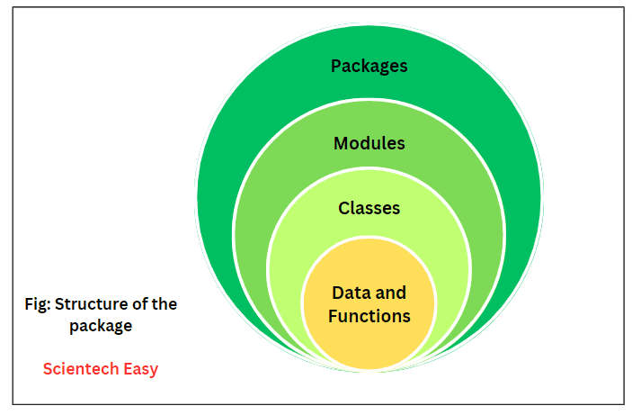

Slide 4
File Handling
File handling in Python means reading from and writing to files stored on your computer (like .txt, .csv, .json, etc.)
It helps your program store data permanently, even after the program stops running.
For example:
You can save user data in a file.
You can read input from a file instead of typing it manually.

Slide 5
There are mainly two types of files:
1. Text files (.txt)
2. Binary files

Slide 6
Text files (.txt):
Store data as plain text.
ex.: xyz.txt

Slide 7
Binary files:
Store data in binary (0s and 1s) format.
Not readable by humans.
Ex: images, video files, audio files;

Slide 8
File Handling Steps:
Open the file
Read or Write data
Close the file

Slide 9
Opening a file
In Python, you use the built-in open() function
Syntax: f = open(filename, mode)

Slide 10
modes
Mode | Meaning | Description
'r' | Read | Opens file for reading (default). Error if file doesn’t exist.
'w' | Write | Opens file for writing. Creates a new file or overwrites existing one.
'a' | Append | Opens file for writing. Adds new data at the end of the file.
'x' | Create | Creates a new file. Gives error if file already exists.
'r+' | Read + Write | Opens file for reading and writing.
'b' | Binary mode | Used with binary files (e.g., 'rb', 'wb').

Slide 11
Write to a File
file = open("example.txt", "w")
file.write("Hello, this is Python file handling!\n")
file.write("We are writing data into a file.")
file.close()

Slide 12
Read from a File
file = open("example.txt", "r")
content = file.read()
print(content)
file.close()

Slide 13
Append to a File
file = open("example.txt", "a")
file.write("\nNow we are appending new data!")
file.close()

Slide 14
Various properties of file object
Name: name of a opened file;
Mode:mode in which the file is opened;
Closed: returns the boolean value indicates the file is closed or not
Readable(): returns the boolean value indicates the whether file is readable or not;
Writable(): returns the boolean value indicates the whether file is writable or not;

Slide 15
f= open("cse_class.txt", "w")
print("file name ::", f.name)
print("file mode ::", f.mode)
print("is file readable ::", f.readable())
print("is file writable ::", f.writable())
print("is file closed ::", f.closed)
f.close()
print("is file closed ::", f.closed)

Slide 16
Reading character data from text files
Read(): total data
Read(n): “n” characters from file
Readline() : only one line
Readlines(): all lines

Slide 17
Read()
file = open("sample.txt", "r")
data = file.read()
print(data)
file.close()

Slide 18
Read(n)
file = open("sample.txt", "r")
data = file.read(10)
print(data)
file.close()

Slide 19
Readline()
file = open("sample.txt", "r")
line1 = file.readline()
print("Line 1:", line1.strip())
line2 = file.readline()
print("Line 2:", line2.strip())
file.close()

Slide 20
Readlines()
file = open("sample.txt", "r")
lines = file.readlines()
print(lines)
file.close()

Slide 21
With statement
The with statement is used to open a file safely. It automatically closes the file after the block of code is done — so you don’t need to write file.close() manually.

Slide 22
with open("example.txt", "w") as file:
file.write("Python File Handling Example\n")
file.write("This file is handled using 'with' statement.\n")
# file is automatically closed after 'with' block
print(file.closed)
# Output: True

Slide 23
with open("example.txt", "w") as file:
file.write("Python File Handling Example\n")
file.write("This file is handled using 'with' statement.\n")
# file is automatically closed after 'with' block
print(file.closed)
# Output: True

Slide 24
Tell()
tell() returns the current position of the file cursor (in bytes).
When a file is opened, the cursor starts at position 0 (the beginning).

Slide 25
Seek()
seek(offset) moves the file cursor to a specific position (in bytes) inside the file.
seek(0) → move cursor to start
seek(n) → move cursor to nth byte

